Slide 1
Pupil Size
and
Brain States
Wu Jiqing
201522592
Supervisor: Shuzo Sakata

Slide 2
1. Introduction
2. Methodology
3. Results
4. Conclusion
Content

Slide 3
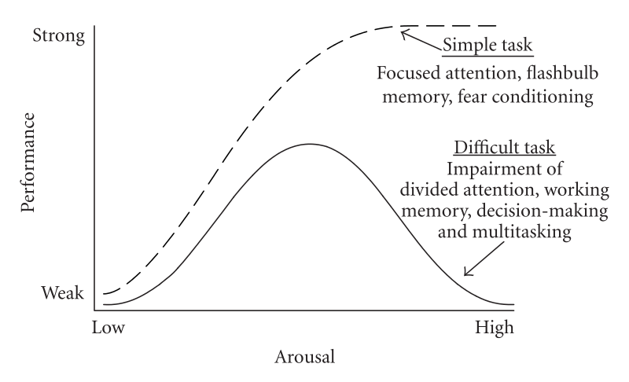
01
Introduction
Yerks-Dodson’s Law (1908)
- Inverted-U relationship between arousal level and performance
Function of
brain states

Slide 4
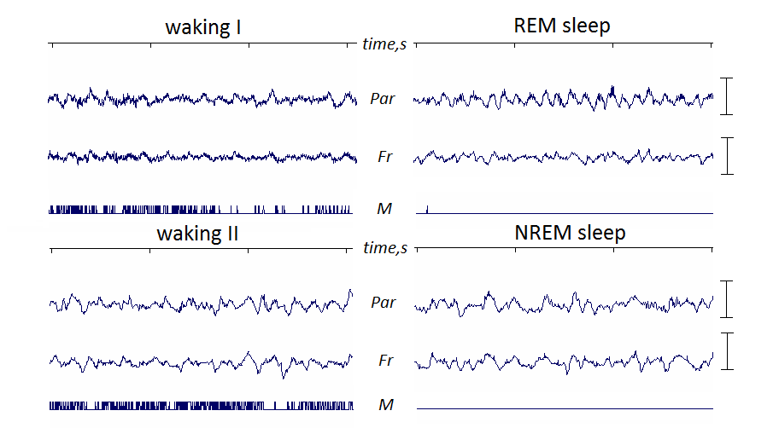
01
Introduction
NREM
Brain States– Classified by EEG signals
REM sleep (Dreams)
REM
Awake state
NREM sleep (Memory)

Slide 5
01
Introduction
Pupil Dynamics – function as a state assessment
Parasympathetic nerve
Iris sphincter muscle
Pupil constriction
Sympathetic nerve
dilatory papillary muscle
pupil dilation
Behaviors detection
-focusing on tasks
-decision making
Disease diagnosis
Parkinson disease
- Autism Spectrum Disorder

Slide 6
01
Introduction
Hypothesis
Pupil dynamics
Brain states (NREM, REM, Awake)

Slide 7
02
Methodology
Sleeping Score Recording
(EEG Signals→
sleeping scores)
Sleeping Score
NREM
REM
Awake state
15 Male Mice
(8-26 weeks old)
(28.1 ± 3.0g)
Pupil monitoring
(under infrared light)

Slide 8
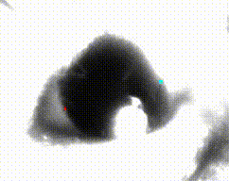
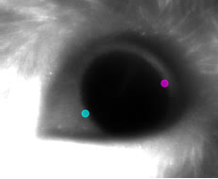
02
Methodology
DeepLabCut (convolutional neural networks)
Label the right and left edges of pupil
Train networks on GPU-based computer
Pupil videos
Extract frames randomly
The data of pupil diameters

Slide 9
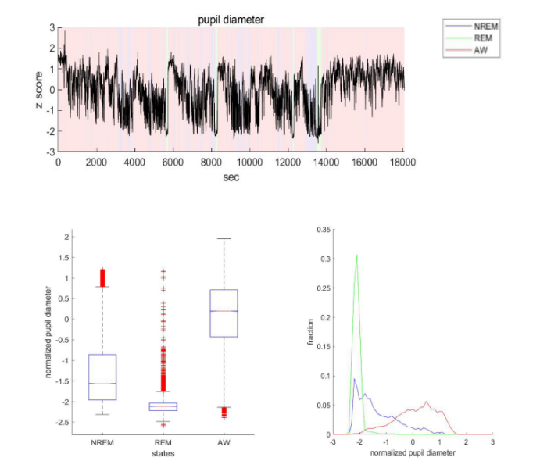
03
Results
Data from an example
zscore of pupil diameter vs. time

Slide 10
03
Results
Data from an example
NREM sleep -1.5653
REM sleep -2.1133
Awake states 0.1947

Slide 11
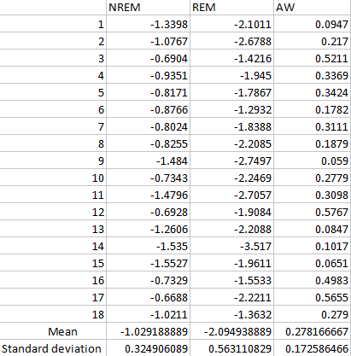
03
Results
Data from 18 data sets
One-Way ANOVA
P-value: 3.32016e-23

Slide 12
04
Conclusion
(1) The changing of pupil size correlate with the alteration of brain states.
the potential to be developed as a biomarker in disease diagnosis.
(mental disorders)

Slide 13
04
Conclusion
(2) DeepLabCut exhibits good performance in video-based pupil detection.
-Time efficient
-Images with incomplete pupil can be used
-No influence caused by illumination changing

Slide 14
THANK YOU FOR WATCHING

